Slide 1
Pipeline: Introduction
Theseslides arederivedfrom: CSCE430/830Computer
ArchitecturecoursebyProf. Hong Jiang andDavePaterson©UCB
Somefiguresandtables have be nderivedfrom : ComputerSystem Architectureby M.MorrisMano

Slide 2
Pipelining Outline
Introduction Defining Pipelining Pipelining Instructions
Hazards
Structural hazards Data Hazards Control Hazards

Slide 3
What is Pipelining?
A way of speeding up execution of instructions
Key idea:
overlap execution of multiple instructions

Slide 4
The Laundry Analogy
●
Ann, Brian, Cathy, Dave
each have one load of clothes to wash, dry, and fold
A B C D
●
Washer takes 30 minutes
●
Dryer takes 30 minutes
●
“Folder” takes 30 minutes
●
“Stasher” takes 30 minutes to put clothes into drawers

Slide 5
If we do laundry sequentially...
6 PM 12
7 8 10 11 1
2 AM
9
●
30 | 30 | 30 | 30 | 30 | 30 | 30 | 30 | 30 | 30 | 30 | 30 | 30 | 30 | 30 | 30
●
Time
T
a s k
O
r C
d e r
A
B
D

Slide 6
To Pipeline, We Overlap Tasks
6 PM 12 2 AM
7 8 10 11 1
9
Time
Pipelining doesn’t help latency of single task, it helps throughput of entire workload
Pipeline rate limited by slowest
pipeline stage
Multiple tasks operating simultaneously
Potential speedup = Number pipe stages
Unbalanced lengths of pipe stages reduces speedup
Time to “fill” pipeline and time to “drain” it reduces speedup
30
30 30 30 30 30 30
•
T
a s k
O
r d
e D
r
A
B
•
C
•
•
•
•
12

Slide 7
Pipelining a Digital System
●
●
Key idea: break big computation up into pieces
1ns
Separate each piece with a pipeline register
●
200ps
200ps
200ps
200ps
200ps
Pipeline Register

Slide 8
Pipelining a Digital System
Why do this? Because it's faster for repeated computations
Non-pipelined: 1operationfinishes every1ns
1ns
Pipelined: 1operationfinishes every200ps
200ps
200ps
200ps
200ps
200ps

Slide 9
Comments about pipelining
Pipelining increases throughput, but not latency Answer available every 200ps, BUT
-A single computation still takes 1ns Limitations:
-Computations must be divisible into stage size
-Pipeline registers add overhead

Slide 10
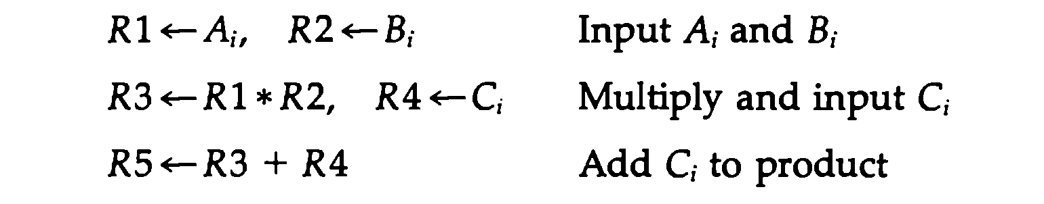
Suppose we need to perform multiply and add operation with a stream of numbers
●
●
●
Each subinstruction is implemented in a segment within the pipeline. Each segment has one or two regsiters and a combinational circuit
The sub operations performed in each segement are as follows
●
●
●

Slide 11
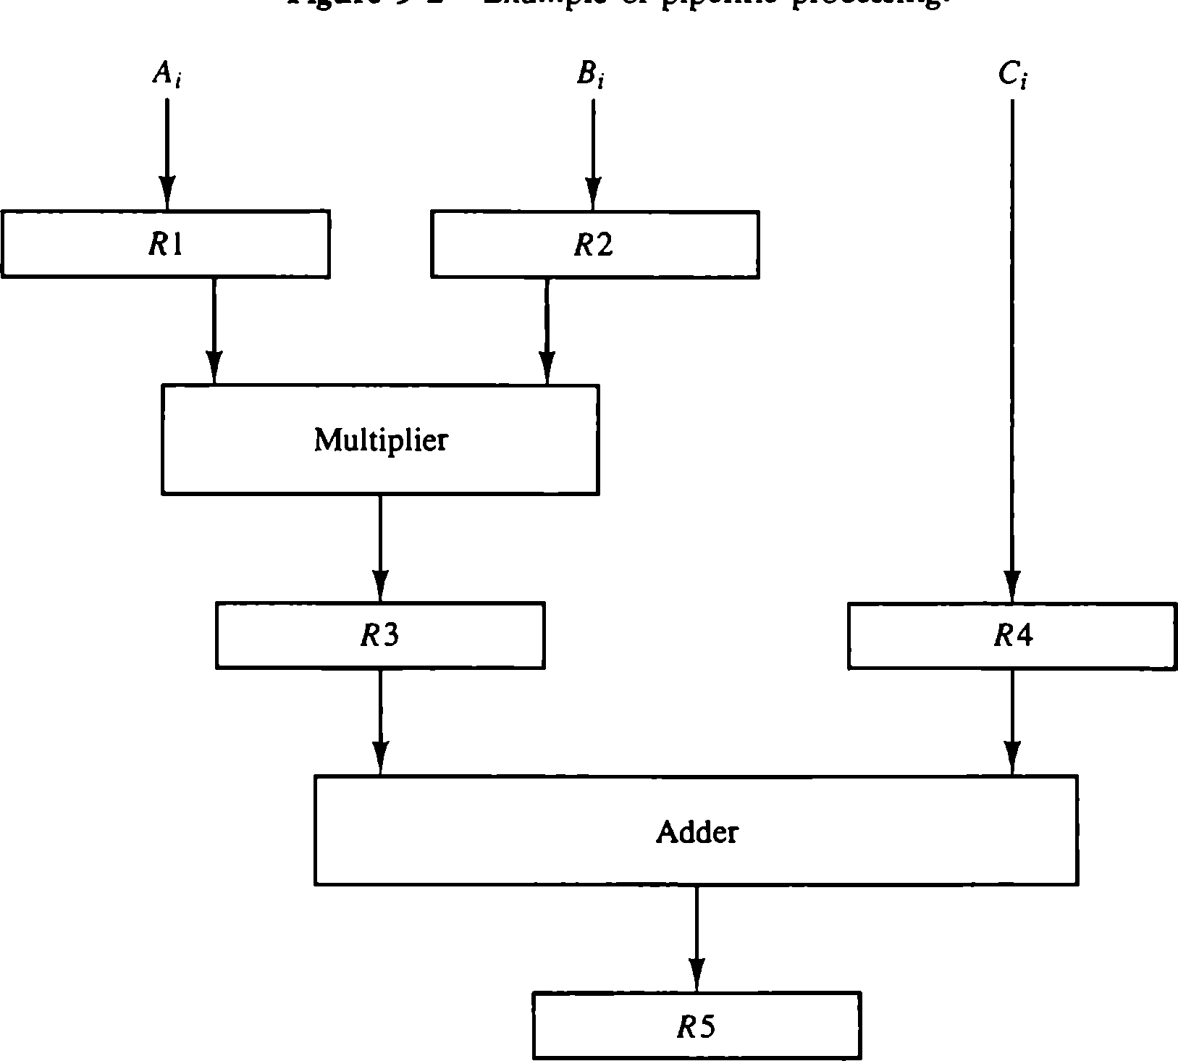
Example of Pipeline Processing

Slide 12
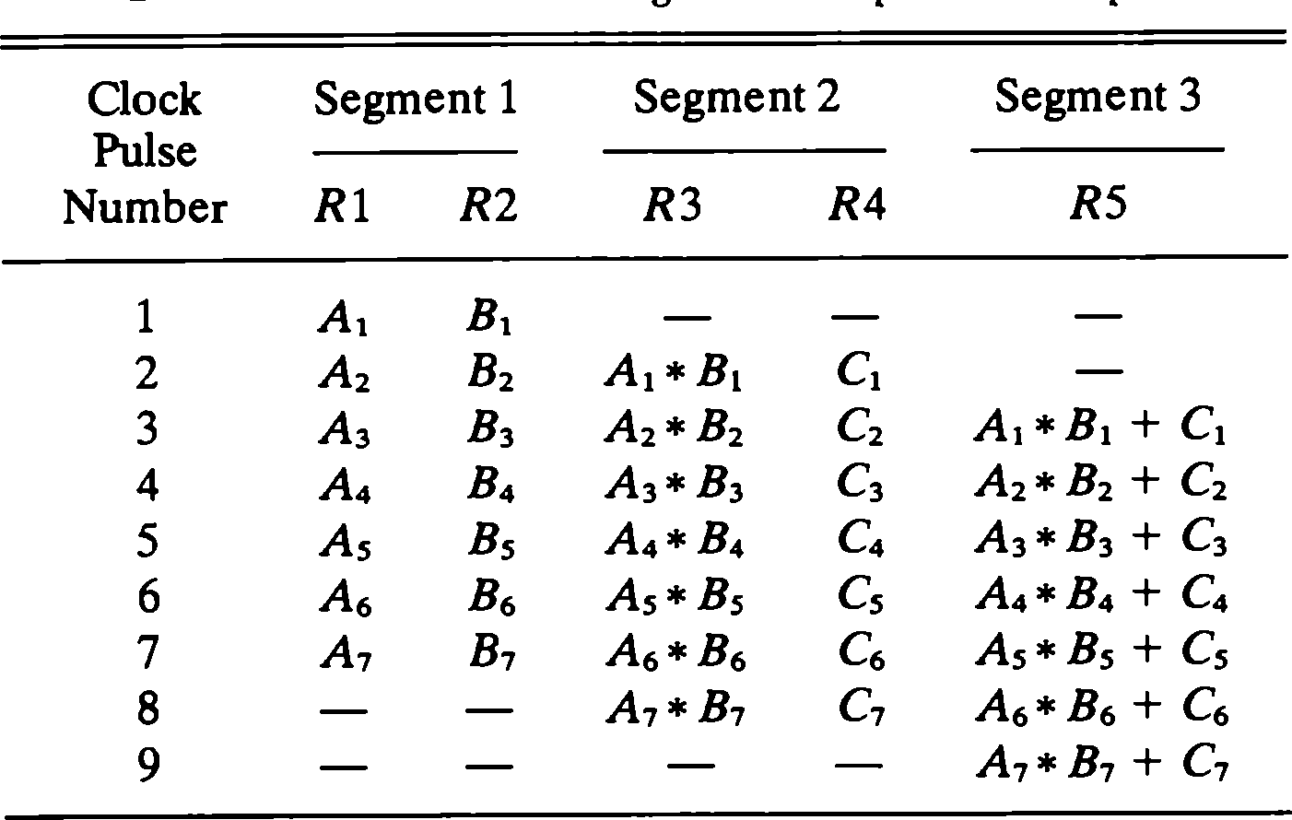
Content of Registers in Pipeline

Slide 13
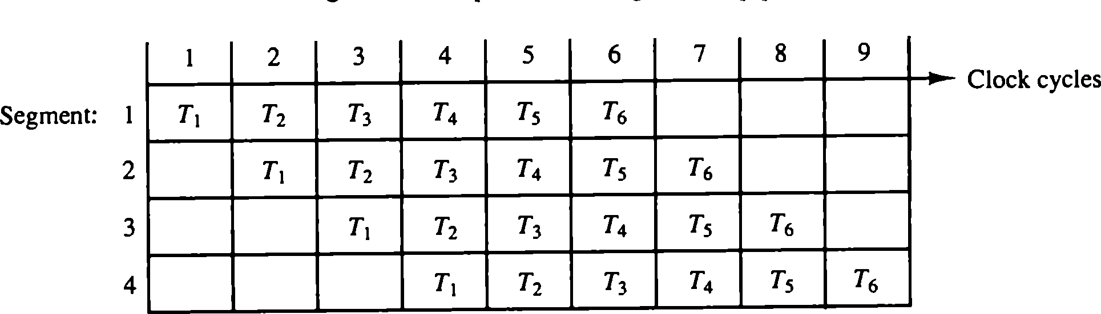
Space Time Diagram of Pipeline

Slide 14
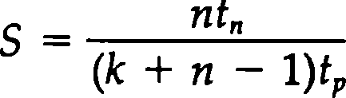
Speedup
Speedup from pipeline
= Average instruction time unpiplined/Average instruction time pipelined
Consider a case for k-segment pipeline with a clock cycle time tp to execute n tasks. The first task T1 requires a time equal to k*tp to complete its operation since there are k segments in pipeline. The remaining n-1 tasks emerge from the pipe at a rate of one task per clock cycle and they will be completed in k+n-1 clock cycles.
Next, to concsider an unpipeline unit that performs the same operation and takes a time equal to tn to complete the task. The total time required fro n tasks is n*tn. The speed up of a pipeline processing over an equivalent non-pipeline processing is defined by the ratio

Slide 15
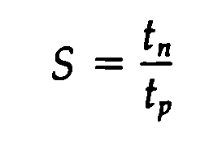

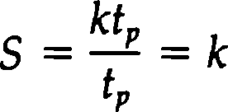
Speedup
●
As the number of tasks increase n becomes much larger than k-1, and k+n-1 approaches
the value of n. Under this condition, the speed up becomes
●
If we assume the the time taken to process the task is the same as in the pipeline and nonpipeline circuits, we will have
The speedup then reduces to numer of stages of pipeline
●

Slide 16
Pipelining a Processor
Recall the 5 steps in instruction execution:
Instruction Fetch (IF)
Instruction Decode and Register Read (ID)
Execution operation or calculate address (EX)
Memory access (MEM)
Write result into register (WB)
Review: Single-Cycle Processor
All 5 steps done in a single clock cycle
Dedicated hardware required for each step

Slide 17
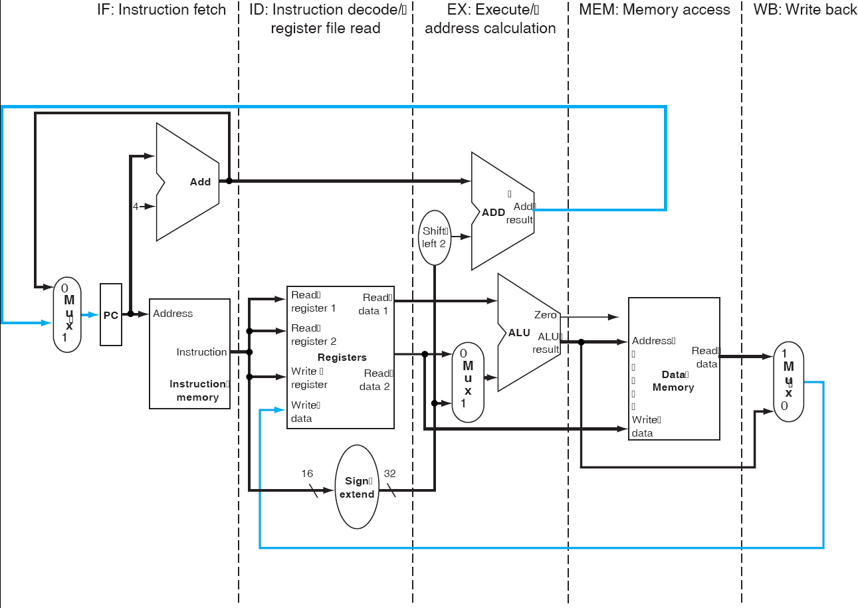
Review - Single-Cycle Processor

Slide 18




The Basic Pipeline For MIPS
Cycle 1Cycle 2 Cycle 3 Cycle 4Cycle 5 Cycle 6Cycle 7
I
n s t r.
ALU
Ifetch
Reg
DMem
Reg
Ifetch
Reg
ALU
DMem
Reg
O
r d e r
Ifetch
Reg
ALU
DMem
Reg
Ifetch
Reg
ALU
DMem
Reg

Slide 19
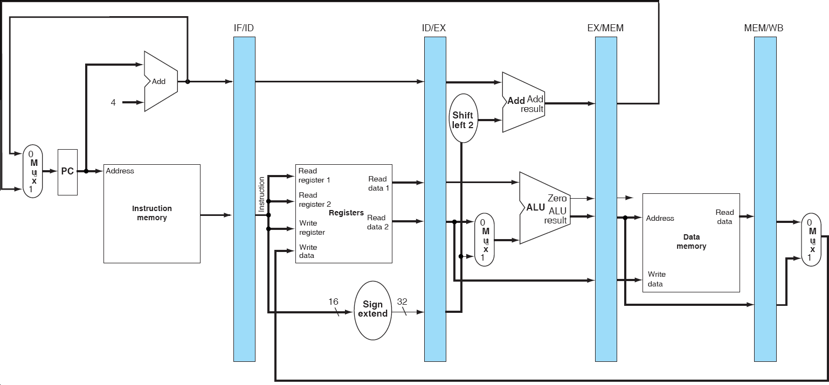
Basic Pipelined Processor

Slide 20
Single-Cycle vs. Pipelined Execution
Non-Pipelined
Instruction 0
20
40
60
80 10 0 120 140 160 180
Time
Order
lw | $1, | 100($0)
lw | $2, | 200($0)
lw | $3, | 300($0)
Instruction Fetch
REG RD
ALU
MEM
REG WR
Instruction Fetch
REG RD
ALU MEM
REG WR
80 ps
Instruction
Fetch
80 ps
80 ps
Pipelined
Instruction
0 20
40
60
80 10 0 120 140 160
Time
Order
lw | $1, | 100($0)
lw | $2, | 200($0)
lw | $3, | 300($0)
Instruction Fetch
REG RD
ALU
MEM
REG WR
Instruction Fetch
REG RD
ALU
MEM
REG WR
20 ps
Instruction Fetch
REG RD
ALU
MEM
REG WR
20 ps
20 ps 20 ps 20 ps 20 ps 20 ps

Slide 21
Comments about Pipelining
The good news
Multiple instructions are being processed at same time
This works because stages are isolated by registers
Best case speedup of N
The bad news
- Instructions interfere with each other - hazards
Example: different instructions may need the same piece of hardware (e.g., memory) in same clock cycle
Example: instruction may require a result produced by an earlier instruction that is not yet complete

Slide 22
Pipeline Hazards
Limits to pipelining: Hazards prevent next instruction from executing during its designated clock cycle
Structural hazards: two different instructions use same h/w in same cycle
Data hazards: Instruction depends on result of prior instruction still in the pipeline
Control hazards: Pipelining of branches & other instructions that change the PC

Slide 23
Why it’s important…
If you're a hardware designer OR a complier writer, you need to be aware of how HLL is mapped to assembly instructions AND what HW is used to execute a sequence of assembly instructions
Otherwise, it is quite possible to always have built in inefficiencies

Slide 24
Pipelining hazards
Pipeline hazards prevent next instruction from executing during designated clock cycle
There are 3 classes of hazards:
Structural Hazards:
Arise from resource conflicts
HW cannot support all possible combinations of instructions
Data Hazards:
Occur when given instruction depends on data from an instruction ahead of it in pipeline
Control Hazards:
Result from branch, other instructions that change flow of program (i.e. change PC)

Slide 25
How do we deal with hazards?
Often, pipeline must be stalled
Stalling pipeline usually lets some instruction(s) in pipeline proceed, another/others wait for data, resource, etc.
A note on terminology:
If we say an instruction was “issued later than instruction x”, we mean that it was issued after instruction x and is not as far along in the pipeline
If we say an instruction was “issued earlier than instruction x”, we mean that it was issued before instruction x and is further along in the pipeline

Slide 26
Stalls and performance
Stalls impede progress of a pipeline and result in deviation from 1 instruction executing/clock cycle
Pipelining can be viewed to:
Decrease CPI or clock cycle time for instruction
Let’s see what affect stalls have on CPI…
CPI pipelined =
Ideal CPI + Pipeline stall cycles per instruction
1 + Pipeline stall cycles per instruction

Slide 27
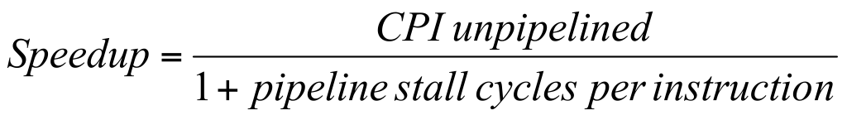
Stalls and performance
Ignoring overhead and assuming stages are balanced:
If no stalls, speedup equal to # of pipeline stages in ideal case

Slide 28
STRUCTURAL HAZARDS

Slide 29
Structural hazards
Avoid structural hazards by duplicating resources
– e.g. an ALU to perform an arithmetic operation and an adder to increment PC
If not all possible combinations of instructions can be executed, structural hazards occur
Pipelines stall result of hazards, CPI increased from the usual “1”

Slide 30
An example of a structural hazard
Load
Mem
Reg
ALU
DM
Reg
Instruction 1
Mem
Reg
ALU
DM
Reg
Instruction 2
Mem
Reg
ALU
DM
Reg
Instruction 3
Mem
Reg
ALU
DM
Reg
Instruction 4
Mem
Reg
ALU
DM
Reg
Time
What’s the problem here?

Slide 31
How is it resolved?
Load
Mem
Reg
ALU
DM
Reg
Instruction 1
Mem
Reg
ALU
DM
Reg
Instruction 2
Mem
Reg
ALU
DM
Reg
Stall
Bubble
Bubble
Bubble
Bubble
Bubble
Instruction 3
ALU
DM
Reg
Mem
Reg
Pipeline generally stalled by
Time
inserting a “bubble” or NOP

Slide 32
Or alternatively…
Clock Number
Inst. # | 1 | 2 | 3 | 4 | 5 | 6 | 7 | 8 | 9 | 10
LOAD | IF | ID | EX | MEM | WB
Inst. i+1 |  | IF | ID | EX | MEM | WB
Inst. i+2 |  |  | IF | ID | EX | MEM | WB
Inst. i+3 |  |  |  | stall | IF | ID | EX | MEM | WB
Inst. i+4 |  |  |  |  |  | IF | ID | EX | MEM | WB
Inst. i+5 |  |  |  |  |  |  | IF | ID | EX | MEM
Inst. i+6 |  |  |  |  |  |  |  | IF | ID | EX
LOAD instruction “steals” an instruction fetch cycle which will cause the pipeline to stall.
Thus, no instruction completes on clock cycle 8

Slide 33
What’s the realistic solution?
Answer: Add more hardware.
(especially for the memory access example – i.e. the common case)
CPI degrades quickly from our ideal ‘1’ for even the simplest of cases…

Slide 34
DATA HAZARDS

Slide 35
Data hazards
These exist because of pipelining
Why do they exist???
Pipelining changes when data operands are read, written
Order differs from order seen by sequentially executing instructions on un-pipelined machine
Consider this example:
ADD R1, R2, R3
SUB R4, R1, R5
AND R6, R1, R7
OR R8, R1, R9
– XOR R10, R1, R11
All instructions after ADD use result of ADD
ADD writes the register in WB but SUB needs it in ID.
This is a data hazard

Slide 36
Illustrating a data hazard
CC 1 CC 2 CC 3 CC 4
CC 5 CC 6
ADD R1, R2, R3
Mem
Reg
ALU
DM
Reg
SUB R4, R1, R5
Mem
Reg
ALU
DM
Reg
AND R6, R1, R7
Mem
Reg
ALU
DM
OR R8, R1, R9
Mem
Reg
ALU
XOR R10, R1, R11
Mem
Reg
Time
ADD instruction causes a hazard in next 3 instructions b/c register not written until after those 3 read it.

Slide 37
Forwarding
Problem illustrated on previous slide can actually be solved relatively easily – with forwarding
Can we move the result from EX/MEM register to the beginning of ALU (where SUB needs it)?
Yes!
Generally speaking:
Forwarding occurs when a result is passed directly to functional unit that requires it.
Result goes from output of one unit to input of another

Slide 38
When can we forward?
ADD R1, R2, R3
Mem
Reg
ALU
DM
Reg
SUB gets info. from EX/MEM pipe register
SUB R4, R1, R5
Mem
Reg
ALU
DM
Reg
AND gets info. from MEM/WB pipe register
AND R6, R1, R7
Mem
Reg
ALU
DM
OR R8, R1, R9
Mem
Reg
ALU
OR gets info. by forwarding from register file
XOR R10, R1, R11
Mem
Reg
Time
Rule of thumb:
If line goes “forward” you can do forwarding.
If its drawn backward, it’s physically impossible.

Slide 39
Forwarding doesn’t always work
LW R1, 0(R2)
IM
Reg
ALU
DM
Reg
Load has a latency that forwarding can’t solve.
SUB R4, R1, R5
IM
Reg
ALU
DM
Pipeline must stall until hazard cleared (starting with instruction that wants to use data until source produces it).
AND R6, R1, R7
IM
Reg
ALU
OR R8, R1, R9
IM
Reg
Time
Can’t get data to subtract b/c result needed at beginning of CC #4, but not produced until end of CC #4.

Slide 40
The solution pictorially
LW R1, 0(R2)
IM
Reg
ALU
DM
Reg
SUB R4, R1, R5
IM
Reg
ALU
DM
Bubble
AND R6, R1, R7
IM
ALU
Bubble
Reg
OR R8, R1, R9
Bubble
IM
Reg
Time
Insertion of bubble causes # of cycles to complete this sequence to grow by 1

Slide 41
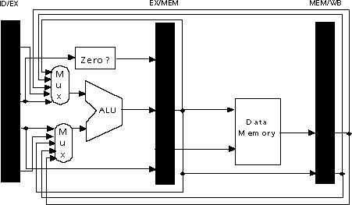
HW Change for Forwarding
Idea: send result just calculated back around to ALU inputs
Send output of memory back to ALU too…

Slide 42
Data hazard specifics
There are actually 3 different kinds of data hazards:
Read After Write (RAW)
Write After Write (WAW)
Write After Read (WAR)
With an in-order issue/in-order completion machine, we’re not as concerned with WAW, WAR

Slide 43
Read after write (RAW) hazards
With RAW hazard, instruction j tries to read a source operand before instruction i writes it.
Thus, j would incorrectly receive old or incorrect value
Graphically/Example:
…
j
i
…
i: ADD R1, R2, R3
j: SUB R4, R1, R6
Instruction j is a read instruction issued after i
Instruction i is a write instruction issued before j
Can use stalling or forwarding to resolve this hazard

Slide 44
Memory Data Hazards
Seen register hazards, can also have memory hazards
RAW:
store R1, 0(SP)
load R4, 0(SP)
 | 1 | 2 | 3 | 4 | 5 | 6
Store R1, 0(SP) | F | D | EX | M | WB
Load R1, 0(SP) |  | F | D | EX | M | WB
In simple pipeline, memory hazards are easy
In order, one at a time, read & write in same stage
In general though, more difficult than register hazards

Slide 45
Data hazards and the compiler
Compiler should be able to help eliminate some stalls caused by data hazards
i.e. compiler could not generate a LOAD instruction that is immediately followed by instruction that uses result of LOAD’s destination register.

Slide 46
What about control logic?
For MIPS integer pipeline, all data hazards can be checked during ID phase of pipeline
If data hazard, instruction stalled before its issued
Whether forwarding is needed can also be determined at this stage, controls signals set
If hazard detected, control unit of pipeline must stall pipeline and prevent instructions in IF, ID from advancing

Slide 47
Some example situations
Situation | Example | Action
No Dependence | LW R1, 45(R2) ADD R5, R6, R7 SUB R8, R6, R7 OR R9, R6, R7 | No hazard possible because no dependence exists on R1 in the immediately following three instructions.
Dependence requiring stall | LW R1, 45(R2) ADD R5, R1, R7 SUB R8, R6, R7 OR R9, R6, R7 | Comparators detect the use of R1 in the ADD and stall the ADD (and SUB and OR) before the ADD begins EX
Dependence overcome by forwarding | LW R1, 45(R2) ADD R5, R6, R7 SUB R8, R1, R7 OR R9, R6, R7 | Comparators detect the use of R1 in SUB and forward the result of LOAD to the ALU in time for SUB to begin with EX
Dependence with accesses in order | LW R1, 45(R2) ADD R5, R6, R7 SUB R8, R6, R7 OR R9, R1, R7 | No action is required because the read of R1 by OR occurs in the second half of the ID phase, while the write of the loaded data occurred in the first half.

Slide 48
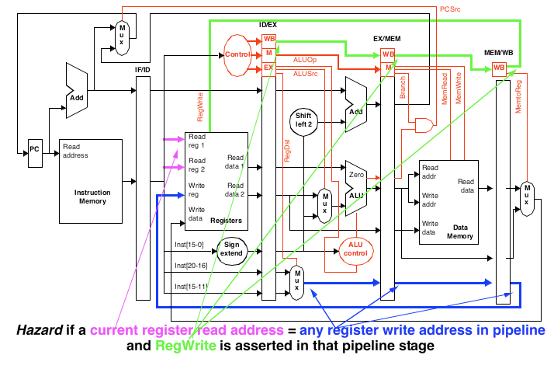
Detecting Data Hazards

Slide 49
Hazards vs. Dependencies
dependence: fixed property of instruction stream
(i.e., program)
hazard: property of program and processor organization
implies potential for executing things in wrong order
potential only exists if instructions can be simultaneously “in-flight”
property of dynamic distance between instructions vs. pipeline depth
For example, can have RAW dependence with or without hazard
depends on pipeline

Slide 50
CONTROL HAZARDS

Slide 51
Branch / Control Hazards
So far, we’ve limited discussion of hazards to:
Arithmetic/logic operations
Data transfers
Also need to consider hazards involving branches:
– Example:
40: beq | $1, $3, 28 | # (28 leads to address 72)
44: and | $12, $2, $5
48: or | $13, $6, $2
52: add | $14, $2, $2
72: lw | $4, 50($7)
How long will it take before the branch decision takes effect?
– What happens in the meantime?

Slide 52
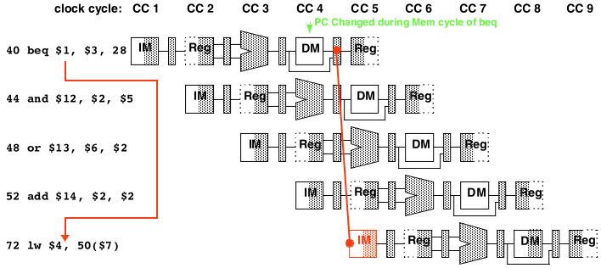
How branches impact pipelined instructions
If branch condition true, must skip 44, 48, 52
But, these have already started down the pipeline
They will complete unless we do something about it
How do we deal with this?
We’ll consider 2 possibilities

Slide 53
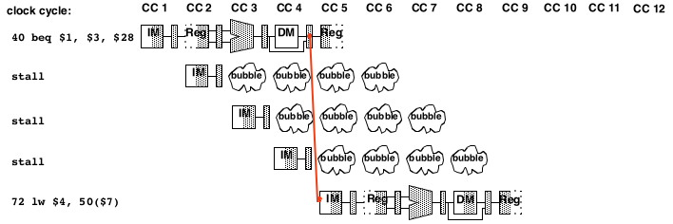
Dealing w/branch hazards: always stall
Branch taken
Wait 3 cycles
No proper instructions in the pipeline
Same delay as without stalls (no time lost)

Slide 54
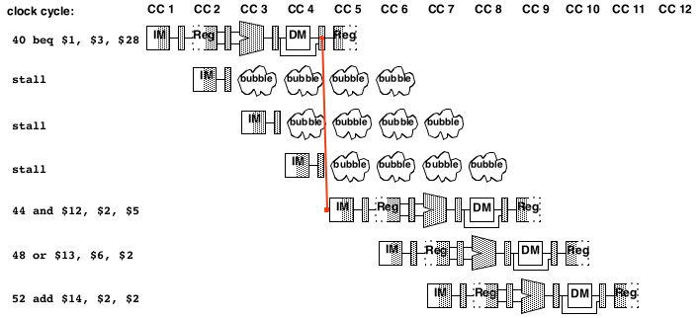
Dealing w/branch hazards: always stall
Branch not taken
Still must wait 3 cycles
Time lost
Could have spent CCs fetching, decoding next instructions

Slide 55
Dealing w/branch hazards
On average, branches are taken ½ the time
If branch not taken…
Continue normal processing
Else, if branch is taken…
Need to flush improper instruction from pipeline
One approach:
Always assume branch will NOT be taken
Cuts overall time for branch processing in ½
If prediction is incorrect, just flush the pipeline

Slide 56
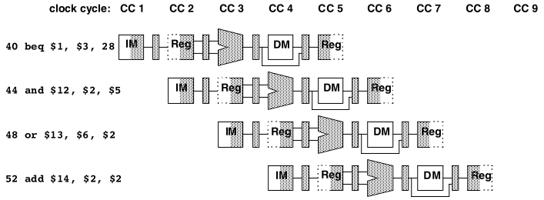
Impact of “predict not taken”
Execution proceeds normally – no penalty

Slide 57
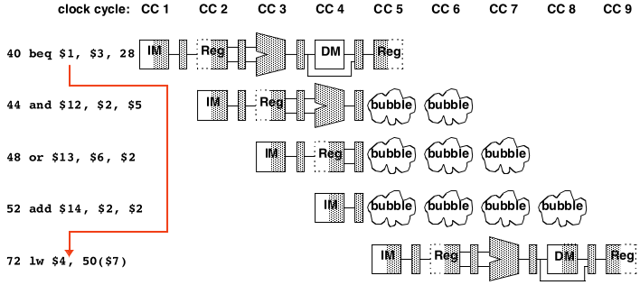
Impact of “predict not taken”
Bubbles injected into 3 stages during cycle 5

Slide 58
Branch Prediction
Prior solutions are “ugly”
Better (& more common): guess possible outcome
Technique is called “branch predicting”; needs 2 parts:
“Predictor” to guess where / if instruction will branch
(and to where)
“Recovery Mechanism”:
i.e. a way to fix your mistake
Prior strategy:
Predictor: always guess branch never taken
Recovery: flush instructions if branch taken
Alternative: accumulate info. in IF stage as to…
Whether or not for any particular PC value a branch was taken next
To where it is taken
How to update with information from later stages

Slide 59
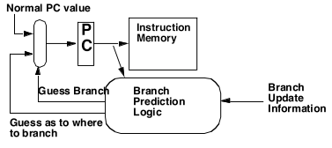
A Branch Predictor

Slide 60
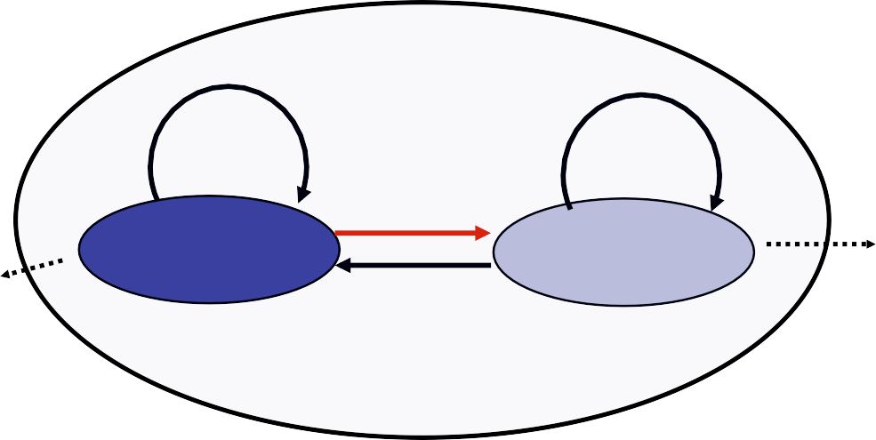
Predictor for a Single Branch
General Form
1. Access
2. Predict Output T/NT
state
PC
3. Feedback T/NT
1-bit prediction
Feedback
T
NT
NT
1
0
Predict Taken
Predict Taken
T

Slide 61


Branch History Table of 1-bit Predictor
BHT also called branch prediction buffer
Can use only one 1-bit predictor, but accuracy is low
BHT: use a table of simple predictors, indexed by bits from PC
More entries, more cost, but less conflicts, higher accuracy
BHT can contain complex predictors
K-bit
Branch
address
₂k
Prediction

Slide 62
1 bit weakness
Example:
– in a loop, 1-bit BHT will cause 2 mispredictions
Consider a loop of 9 iterations before exit:
for (…){
for (i=0; i<9; i++) a[i] = a[i] * 2.0;
}
End of loop case, when it exits instead of looping as before
First time through loop on next time through code, when it predicts exit instead of looping
Only 80% accuracy even if loop 90% of the time

Slide 63
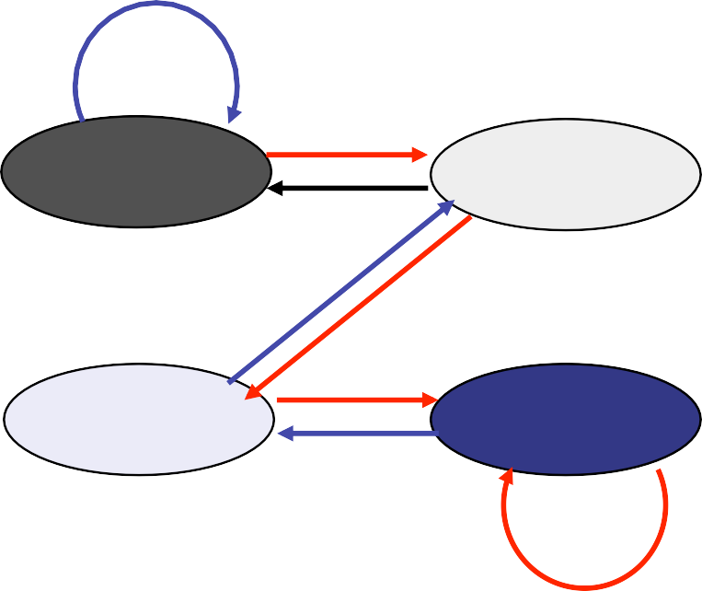
2-bit saturating counter
Solution: 2-bit scheme where change prediction only if get misprediction twice:
T
NT
T
T NT
Predict Taken
11
10
Predict Taken
NT
T
Predict Not Taken
01
00
Predict Not Taken
NT
Blue: stop, not taken
Gray: go, taken
Adds hysteresis to decision making process

Slide 64
Branch target buffer
Branch Target Buffer (BTB): Address of branch index to get prediction AND branch address (if taken)
– Note: must check for branch match now, since can’t use wrong branch address
Example: BTB combined with BHT
Branch PC Predicted PC
PC of instruction FETCH
=?
Extra prediction state bits
Yes: instruction is branch and use predicted PC as next PC
No: branch not
predicted, proceed normally
(Next PC = PC+4)
48

Slide 65
Discussion
How does instruction set design impact pipelining?
Does increasing the depth of pipelining always increase performance?
65

Slide 66
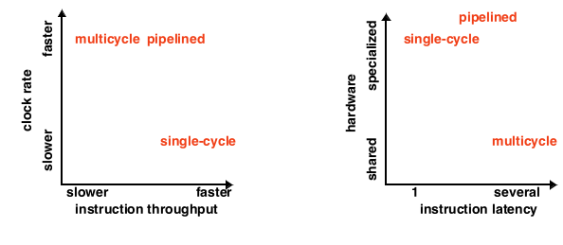

Comparative performance
Throughput: instructions per clock cycle = 1/cpi
Pipeline has fast throughput and fast clock rate
Latency: inherent execution time, in cycles
High latency for pipelining causes problems
Increased time to resolve hazards
Board
51

Slide 67
Technique to reduce branch penalties
Branch delay slot: Location following branch instruction
If execution of branch instruction takes more than one step in pipeline, branch penalty can be reduced by executing instruction in delay slot before branch decision is made.
This concept is called delayed branch, as if the branch execution is delayed by one cycle.

Slide 68
Reducing branch penalties (cont.)
Useful instructions kept in delay slots which are fully executed whether or not branch is taken.
Program executes as if branch instruction was placed after instructions in delay slot.
If no suitable instructions can be put in delay slots, it is filled with instructions which do no-operations. For example, Add R1,0,R1, which does not effect any register or flag.

Slide 69
Control Hazards
• Branches require stalls as they are not resolved till the execution
• Conditional branches are even more difficult
• Every fifth instruction executed is typically a branch in compiled programs
ADD R1,R2,R3
BEQZ R2,X
Delay Slot
..
X:
------
BEQZ R2,X
ADD R1,R2,R3
Delay Slot
…
X

Slide 70
Delayed branch
X: SUB R4,R5,R6 X: ADD R1,R2,R3
ADD R1,R2,R3 BEQZ R1,X
BEQZ R1,X SUB R4,R5,R6
Is this correct?

Slide 71
Instruction Level Parallelism
Constraints
Typically every 6th instruction is a branch
Exploitation of ILP cannot be based on these six instructions alone

Slide 72
Advanced Techniques
Loop unrolling
Basic pipeline scheduling
Dynamic scheduling
Register renaming
Branch prediction
Multiple issue of instructions
Dependence analysis at compilation
Software pipeline
Memory pipeline

Slide 73
Instruction Queue
Fetch Unit: to supply the execution unit with steady stream of instructions.
Stream may be interrupted due to cache miss, data dependency or branch instruction.
Instruction following unconditional branch can not be fetched until decoding of branch instruction and computation of target address.
In conditional branch, the conditional has to be evaluated before fetching next instruction.
Sophisticated fetch units used to fetch several instructions before they are needed and maintain instruction queue.
A dispatch unit takes instructions from the front of the queue and sends them to free execution units.

Slide 74
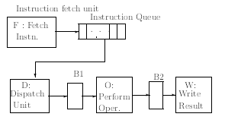
Instruction Queue

Slide 75
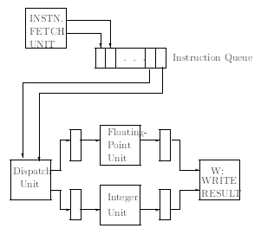
Multiple execution units
Several parallel units for a stage of pipeline

